Slide 1
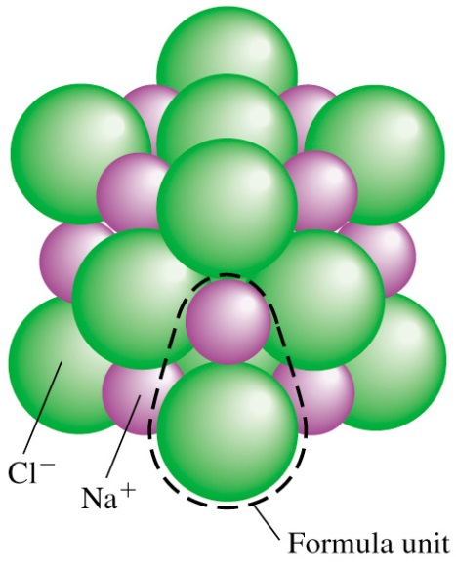
General Chemistry
Principles and Modern Applications
Petrucci • Harwood • Herring
8th Edition
Chapter 3: Chemical Compounds
Philip Dutton
University of Windsor, Canada
Prentice-Hall © 2002
Slide <number> of 37
General Chemistry: Chapter 3
Prentice-Hall © 2002

Slide 2
Contents
3-1 Molecular and Ionic Compounds
3-2 Molecular Mass
3-3 Composition
3-4 Oxidation States
3-5 Names and formulas
Focus on Mass Spectrometry
Slide <number> of 37
General Chemistry: Chapter 3
Prentice-Hall © 2002
Notes:
Chemistry 140 Fall 2002

Slide 3
Chemical Compounds
Two fundamental kinds of chemical bonds hold together the atoms in a compound.
Covalent bonds, which involve a sharing of electrons between atoms, give rise to molecular compounds.
Ionic bonds, which involve a transfer of electrons from one atom to another, give rise to ionic compounds.
Slide <number> of 37
General Chemistry: Chapter 3
Prentice-Hall © 2002
Notes:
Chemistry 140 Fall 2002

Slide 4
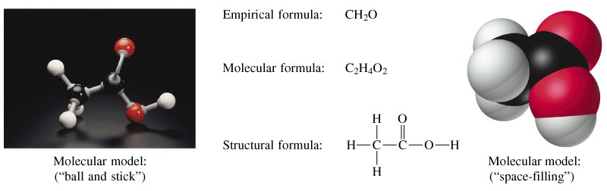
Molecular compounds
A molecular compound is made up of discrete units called molecules, which typically consist of a small number of nonmetal atoms held together by covalent bonds.
1 /inch
0.4 /cm
Slide <number> of 37
General Chemistry: Chapter 3
Prentice-Hall © 2002
Notes:
Chemistry 140 Fall 2002
Chemical formula – relative numbers of atoms of each element present
Empirical formula – the simplest whole number formula
Structural formula – the order and type of attachements
– shows multiple bonds
- may show lone pairs
- hard to show 3-d

Slide 5
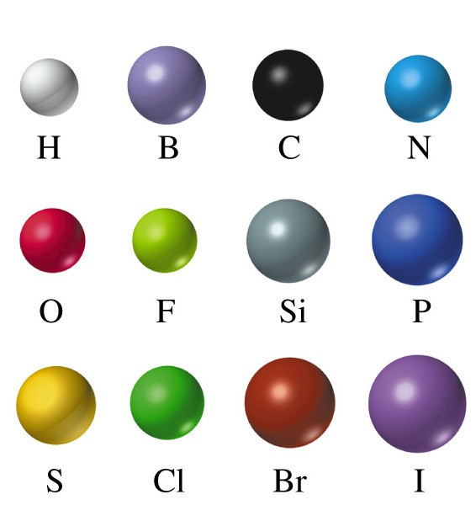
Standard color scheme
Slide <number> of 37
General Chemistry: Chapter 3
Prentice-Hall © 2002

Slide 6
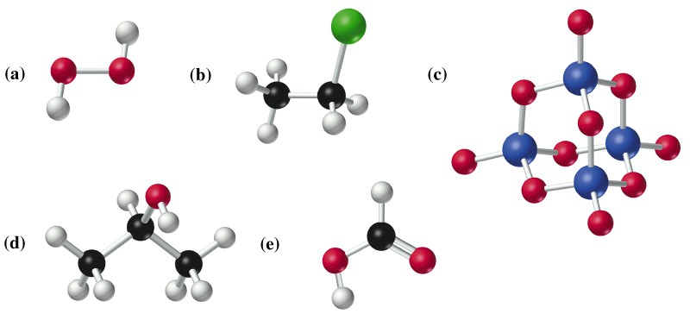
Some molecules
H₂O₂
CH₃CH₂Cl
P₄O₁₀
CH₃CH(OH)CH₃
HCO₂H
Slide <number> of 37
General Chemistry: Chapter 3
Prentice-Hall © 2002

Slide 7
Ionic compounds
Chemical combination of a metal and a nonmetal usually results in an ionic compound. An ionic compound is made up of positive and negative ions joined together by electrostatic forces of attraction
Atoms of almost all elements can gain or lose electrons to form charged species called ions.
Compounds composed of ions are known as ionic compounds.
Metals tend to lose electrons to form positively charged ions called cations.
Non-metals tend to gain electrons to form negatively charged ions called anions.
Slide <number> of 37
General Chemistry: Chapter 3
Prentice-Hall © 2002
Notes:
Chemistry 140 Fall 2002
Positive and negaive ions joined together by electrostatic forces
Metals tend to lose electrons to form cations
Non-metals tend to gain electrons to form anions
Ionic solids formulae are reported as the formula unit – inappropriate to call it a molecular formula

Slide 8
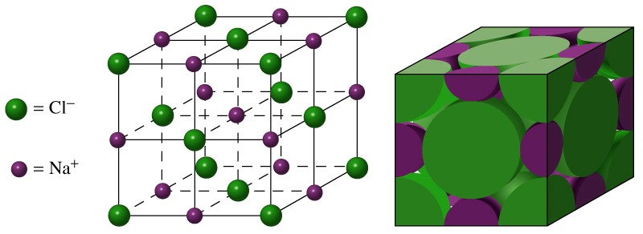
Sodium chloride
Extended array of Na⁺ and Cl⁻ ions Simplest formula unit is NaCl
The formula unit of an ionic compound
is the smallest electrically neutral collection of ions.
Slide <number> of 37
General Chemistry: Chapter 3
Prentice-Hall © 2002
Notes:
Chemistry 140 Fall 2002
Na loses one electron to form the sodium ion
Cl gains one electron to form the chloride ion
Centers of ions are shown in the ball and stick model for clarity
Space filling model shows how the ions are actually in contact with one another.
We will discuss face centered cubic and other types of packing in chapter 13

Slide 9
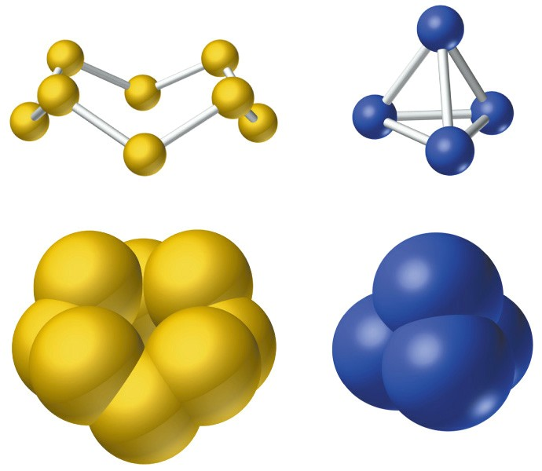
Inorganic molecules
S₈
P₄
Slide <number> of 37
General Chemistry: Chapter 3
Prentice-Hall © 2002
Notes:
Chemistry 140 Fall 2002
Some inorganic compounds for molecules
Sulfur and phosporous for example.
They come in various forms called allotropes – these are one allotrope of each

Slide 10
Molecular mass
Once we know the chemical formula of a compound, we can determine its formula mass.
Formula mass is the mass of a formula unit in atomic mass units. It is always appropriate to use the term formula mass, but, for a molecular compound, the formula unit is an actual molecule, so we can speak of molecular mass.
Molecular mass is the mass of a molecule in atomic mass units.
Slide <number> of 37
General Chemistry: Chapter 3
Prentice-Hall © 2002
Notes:
Chemistry 140 Fall 2002
Glucose
Emprical formula leads us to the name “carbohydrate”

Slide 11
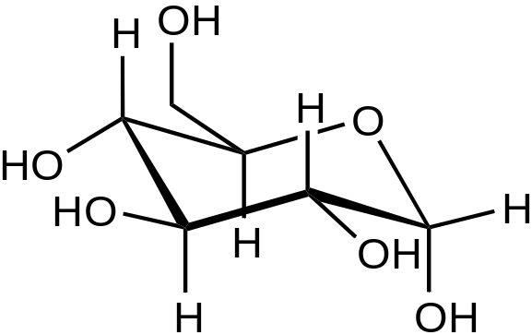
Molecular mass
Glucose
Molecular formula C₆H₁₂O₆
Empirical formula CH₂O
Molecular Mass:
Use the naturally occurring mixture of isotopes,
6 x 12.01 + 12 x 1.01 + 6 x 16.00
= 180.18
Slide <number> of 37
General Chemistry: Chapter 3
Prentice-Hall © 2002
Notes:
Chemistry 140 Fall 2002
Glucose
Emprical formula leads us to the name “carbohydrate”

Slide 12
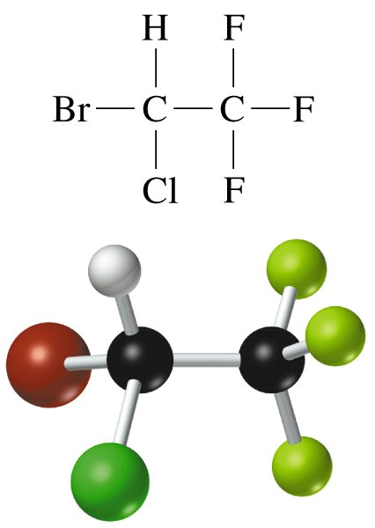
Chemical Composition
The colorless, volatile liquid halothane has been used as a fire extinguisher and also as an inhalation anesthetic.
The molecular formula of tells us that per mole of halothane there are two moles of C atoms, one mole each of H, Br, and Cl atoms, and three moles of F atoms.
Halothane C₂HBrClF₃
Mole ratio n_{C}/n_{halothane}
Mass ratio m_{C}/m_{halothane}
M(C₂HBrClF₃⁾ = 2M_{C} + M_{H} + M_{Br} + M_{Cl} + 3M_{F}
= (2 x 12.01) + 1.01 + 79.90 + 35.45 + (3 x 19.00)
= 197.38 g/mol
Slide <number> of 37
General Chemistry: Chapter 3
Prentice-Hall © 2002
Notes:
Chemistry 140 Fall 2002
Molecular formula tells us there are TWO moles of C per mole of halothane.
We also know about the MASSES of the compound and its elemental components.
Therefore we can talk about PERCENT COMPOSITION BY MASS

Slide 13
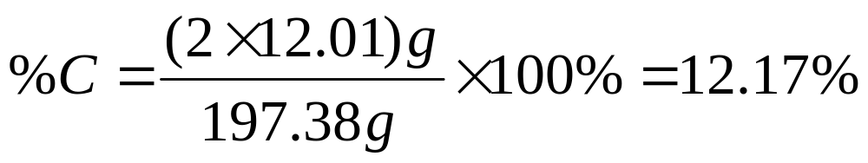
Example 3.4
Calculating the Mass Percent Composition of a Compound
Calculate the molecular mass
M(C₂HBrClF₃⁾ = 197.38 g/mol
For one mole of compound, formulate the mass ratio and convert to percent:
Slide <number> of 37
General Chemistry: Chapter 3
Prentice-Hall © 2002

Slide 14
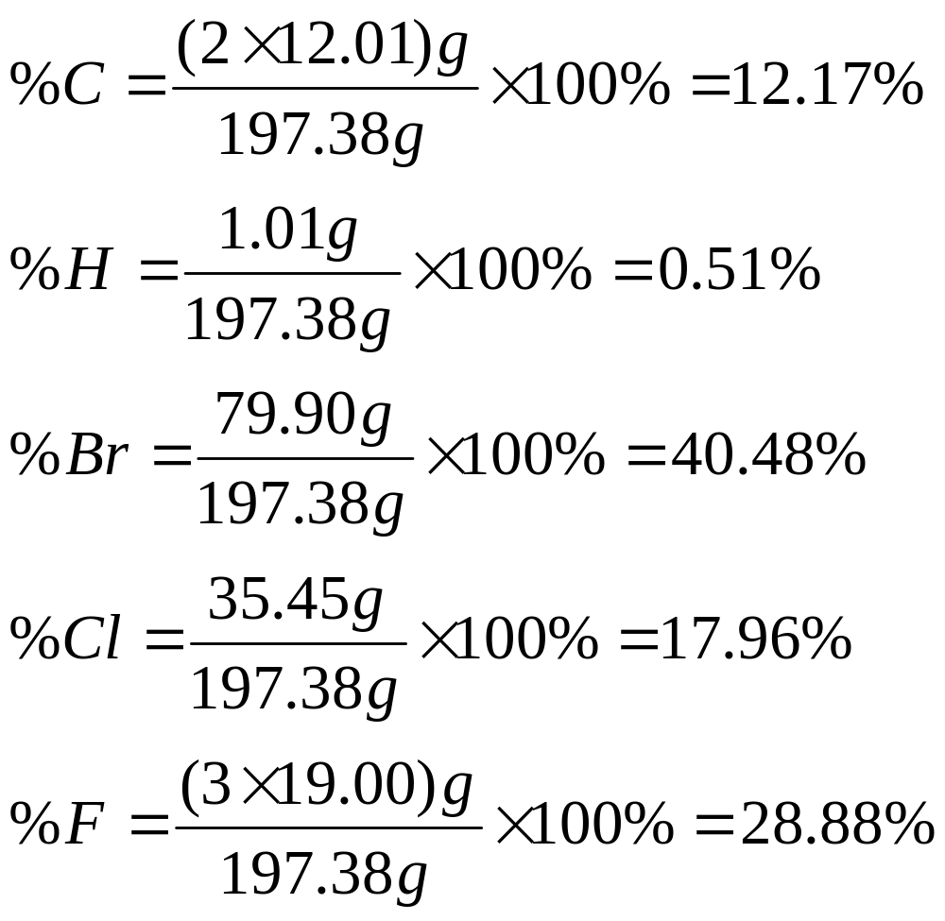
Example
Slide <number> of 37
General Chemistry: Chapter 3
Prentice-Hall © 2002
Notes:
Chemistry 140 Fall 2002
These types of calculations can be carried out in reverse for the following reasons:
Unknown compounds are analyzed for % composition.
Relative proportion of elements present on a mass basis.
Chemical formula requires mole basis, I.e. numbers of atoms.

Slide 15
Example
How many C atoms are present per mole of halothane?
Slide <number> of 37
General Chemistry: Chapter 3
Prentice-Hall © 2002
Notes:
Chemistry 140 Fall 2002
These types of calculations can be carried out in reverse for the following reasons:
Unknown compounds are analyzed for % composition.
Relative proportion of elements present on a mass basis.
Chemical formula requires mole basis, I.e. numbers of atoms.

Slide 16
Determining the Empirical and Molecular Formulas of a Compound from Its Mass Percent Composition
5 Step approach:
Choose an arbitrary sample size (100g).
Convert masses to amounts in moles.
Write a formula.
Convert formula to small whole numbers.
Multiply all subscripts by a small whole number to make the subscripts integral.
Slide <number> of 37
General Chemistry: Chapter 3
Prentice-Hall © 2002
Notes:
Chemistry 140 Fall 2002
If you know the molecular wt it is beneficial to choose that number, then only first three steps are required.

Slide 17
Example 3-5
Determining the Empirical and Molecular Formulas of a Compound from Its Mass Percent Composition.
Dibutyl succinate is an insect repellent used against household ants and roaches. Its composition is 62.58% C, 9.63% H and 27.79% O. Its experimentally determined molecular mass is 230 u. What are the empirical and molecular formulas of dibutyl succinate?
Dibutyl succinate is an insect repellent used against household ants and roaches. Its composition is 62.58% C, 9.63% H and 27.79% O. Its experimentally determined molecular mass is 230 u. What are the empirical and molecular formulas of dibutyl succinate?
Step 1: Determine the mass of each element in a 100g sample.
C 62.58 g H 9.63 g O 27.79 g
Slide <number> of 37
General Chemistry: Chapter 3
Prentice-Hall © 2002
Notes:
Chemistry 140 Fall 2002
Read the problem carefully
Pick out the critical information
Think
Follow the steps to solve the problem

Slide 18
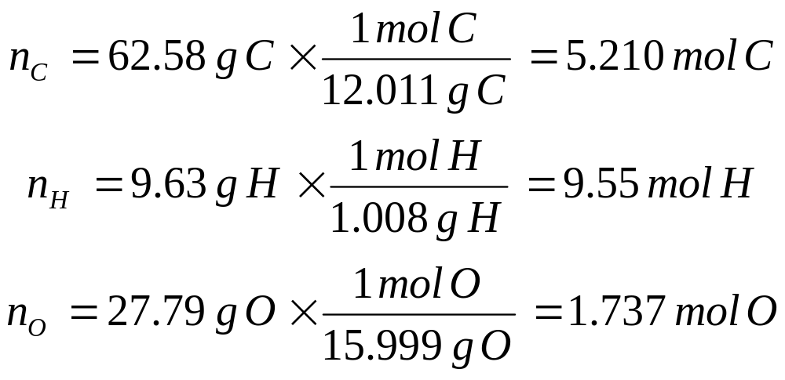
Example 3-5
Step 2: Convert masses to amounts in moles.
Step 3: Write a tentative formula.
C_{5.21}H_{9.55}O_{1.74}
Step 4: Convert to small whole numbers.
C_{2.99}H_{5.49}O
Slide <number> of 37
General Chemistry: Chapter 3
Prentice-Hall © 2002

Slide 19
Example 3-5
Step 5: Convert to a small whole number ratio.
Multiply 2 to get C_{5.98}H_{10.98}O₂
The empirical formula is C₆H₁₁O₂
Step 6: Determine the molecular formula.
Empirical formula mass is 115 u.
Molecular formula mass is 230 u.
The molecular formula is C₁₂H₂₂O₄
Slide <number> of 37
General Chemistry: Chapter 3
Prentice-Hall © 2002
Notes:
Chemistry 140 Fall 2002
Step 5. You can multiply the rounded off one if you wish, but be careful of introducing an error
If all the subscripts are within ±0.1 you are probably OK to round to the integer.
Step 6: Simple multiplication is obvious here.

Slide 20
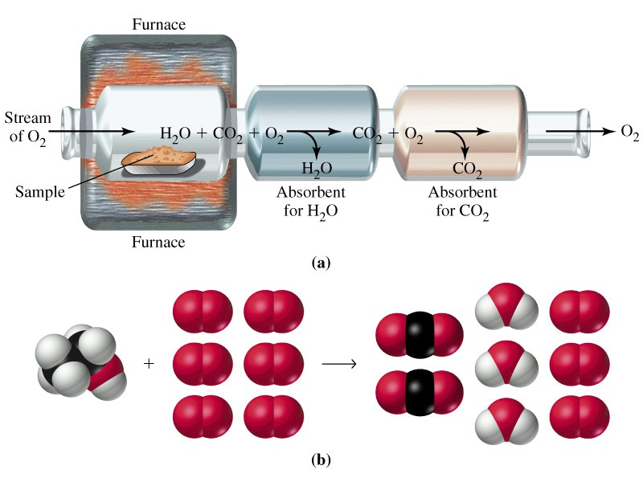
Combustion analysis
Slide <number> of 37
General Chemistry: Chapter 3
Prentice-Hall © 2002
Notes:
Chemistry 140 Fall 2002
Water vapour absorbed by magnesium perchlorate
Carbon dioxide absorbed by sodium hydroxide.
The differences in mass of the absorbers before and after yiled the masses of water and CO₂ produced in the reaction
Combustion takes place in an excess of oxygen so you cannot measure oxygen. Oxygen CAN be analyzed separately but is usually determined by difference.

Slide 21
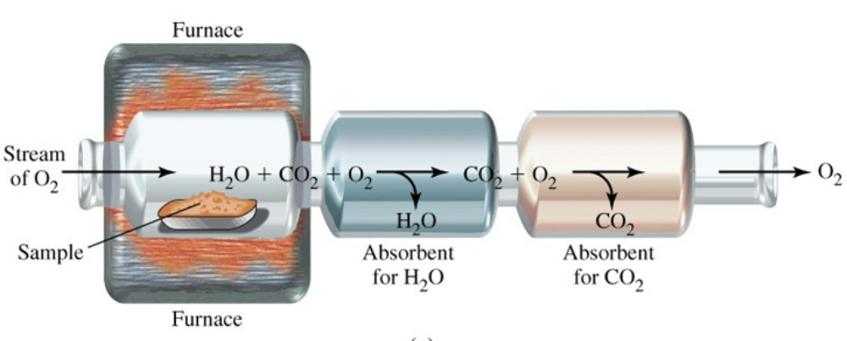
Combustion analysis
In combustion analysis, a weighed sample of a compound is burned in a stream of oxygen gas. The water vapor and carbon dioxide gas produced in the combustion are absorbed by appropriate substances. The increases in mass of these absorbers correspond to the masses of water and carbon dioxide.
Slide <number> of 37
General Chemistry: Chapter 3
Prentice-Hall © 2002
Notes:
Chemistry 140 Fall 2002
Water vapour absorbed by magnesium perchlorate
Carbon dioxide absorbed by sodium hydroxide.
The differences in mass of the absorbers before and after yiled the masses of water and CO₂ produced in the reaction
Combustion takes place in an excess of oxygen so you cannot measure oxygen. Oxygen CAN be analyzed separately but is usually determined by difference.

Slide 22
Combustion analysis
After combustion, all the carbon atoms in the sample are found in the CO2. All the H atoms are in the H2O. Moreover, the only source of the carbon and hydrogen atoms was the sample being analyzed.
Oxygen atoms in the and could have come partly from the sample and partly from the oxygen gas consumed in the combustion. Thus, the quantity of oxygen in the sample has to be determined indirectly.
Slide <number> of 37
General Chemistry: Chapter 3
Prentice-Hall © 2002
Notes:
Chemistry 140 Fall 2002
Water vapour absorbed by magnesium perchlorate
Carbon dioxide absorbed by sodium hydroxide.
The differences in mass of the absorbers before and after yiled the masses of water and CO₂ produced in the reaction
Combustion takes place in an excess of oxygen so you cannot measure oxygen. Oxygen CAN be analyzed separately but is usually determined by difference.

Slide 23
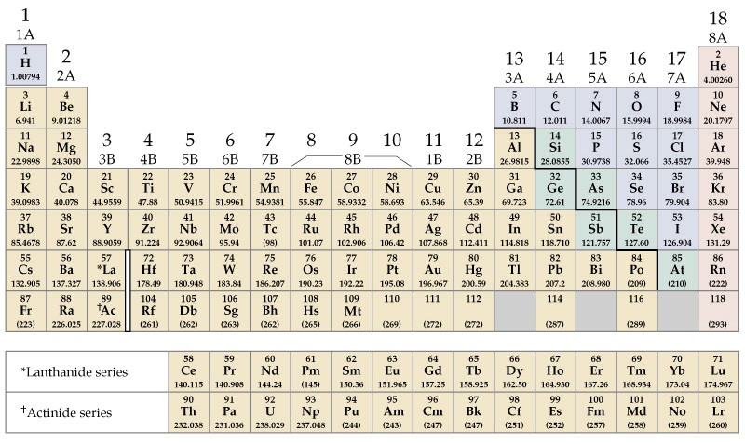
Oxidation States
Metals tend to lose electrons.
Na  Na⁺ + e⁻
Non-metals tend to gain electrons.
Cl + e⁻  Cl⁻
Reducing agents
Oxidizing agents
We use the Oxidation State to keep track of the number of electrons that have been gained or lost by an element.
Slide <number> of 37
General Chemistry: Chapter 3
Prentice-Hall © 2002
Notes:
Chemistry 140 Fall 2002
Metals are electron sources
Non-metals are electron sinks
Sodium goes to the +1 oxidation state
Chlorine goes tot eh –1 oxidation state

Slide 24
Rules for Oxidation States
The oxidation state (OS) of an individual atom in a free element is 0.
The total of the OS in all atoms in:
  Neutral species is 0.
  Ionic species is equal to the charge on the ion.
In their compounds, the alkali metals and the alkaline earths have OS of +1 and +2 respectively.
In compounds the OS of fluorine is always –1
Slide <number> of 37
General Chemistry: Chapter 3
Prentice-Hall © 2002

Slide 25
Rules for Oxidation States
In compounds, the OS of hydrogen is usually +1
In compounds, the OS of oxygen is usually –2.
In binary (two-element) compounds with metals:
  Halogens have OS of –1,
  Group 16 have OS of –2 and
  Group 15 have OS of –3.
Slide <number> of 37
General Chemistry: Chapter 3
Prentice-Hall © 2002

Slide 26
Example 3-7
Assigning Oxidation States.
What is the oxidation state of the underlined element in each of the following? a) P₄; b) Al₂O₃; c) MnO₄⁻; d) NaH
P₄ is an element. P OS = 0
Al₂O₃: O is –2. O₃ is –6. Since (+6)/2=(+3), Al OS = +3.
MnO₄⁻: net OS = -1, O₄ is –8. Mn OS = +7.
NaH: net OS = 0, rule 3 beats rule 5, Na OS = +1 and H OS = -1.
Slide <number> of 37
General Chemistry: Chapter 3
Prentice-Hall © 2002
Notes:
Chemistry 140 Fall 2002
Rule 1 states OS of elements is 0
Rule 2 the total OS is 0, Rule 6 oxygen should be –2 to give a total of –6 for O, therefore 2 Al must be +6 or each Al is +3.
Rule 2 the total OS is –1, Rule 6 oxygen should be –2 to give a total of –8 for O, therefore Mn must be +7.
Rule 2 the total OS is –1, Rule 3 beats Rule 5, so Na OS = +1 and H OS = -1.
There are other examples in the text and much more detail on the rules. Read this material carefully.

Slide 27
Naming Compounds
Trivial names are used for common compounds.
A systematic method of naming compounds is known as a system of nomenclature.
Organic compounds
Inorganic compounds
Slide <number> of 37
General Chemistry: Chapter 3
Prentice-Hall © 2002
Notes:
Chemistry 140 Fall 2002
Trivial names such as water, ammonia, sugar, acetone, ether.

Slide 28
Inorganic Nomenclature
Binary compounds are those formed between two elements. If one of the elements is a metal and the other a nonmetal, the binary compound is usually made up of ions; that is, it is a binary ionic compound. To name a binary compound of a metal and a nonmetal,
write the unmodified name of the metal
then write the name of the nonmetal, modified to end in -ide
NaCl = sodium chloride
electrically neutral
name is unchanged
“ide” ending
MgI₂ = magnesium iodide
Al₂O₃ = aluminum oxide
Na₂S = sodium sulfide
Slide <number> of 37
General Chemistry: Chapter 3
Prentice-Hall © 2002
Notes:
Chemistry 140 Fall 2002
Write the unmodified name of the metal
Then write the name of the nonmetal, modifed to end in ide.
Ionic compounds must be electrically neutral

Slide 29
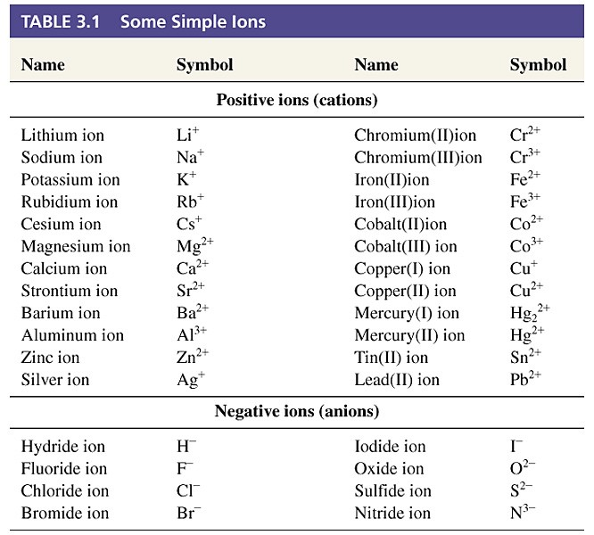
Slide <number> of 37
General Chemistry: Chapter 3
Prentice-Hall © 2002
Notes:
Chemistry 140 Fall 2002
We have already discussed simple anions such as hydride, fluoride, chloride, iodide etc.

Slide 30
Binary Compounds of Two Non-metals
Molecular compounds
usually write the positive OS element first.
HCl hydrogen chloride
Some pairs of nonmetals form more than one binary molecular compound, and we need to distinguish among them. Generally, we indicate relative numbers of atoms through prefixes:
mono 1 penta 5
di 2 hexa 6
tri 3 hepta 7
tetra 4 octa 8
Slide <number> of 37
General Chemistry: Chapter 3
Prentice-Hall © 2002

Slide 31
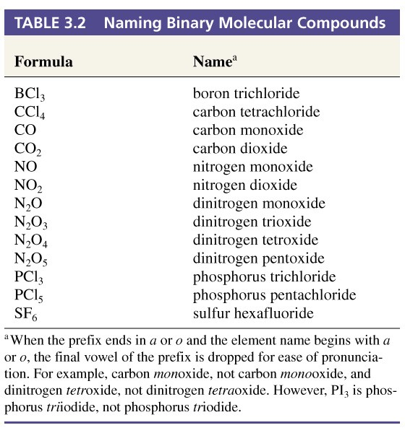
Slide <number> of 37
General Chemistry: Chapter 3
Prentice-Hall © 2002

Slide 32
Binary Acids
Acids produce H⁺ when dissolved in water.
They are compounds that ionize in water.
Emphasize the fact that a molecule is an acid by altering the name.
HCl hydrogen chloride hydrochloric acid
HF hydrogen fluoride hydrofluoric acid
Slide <number> of 37
General Chemistry: Chapter 3
Prentice-Hall © 2002

Slide 33
Polyatomic Ions
Polyatomic ions are very common.
Table 3.3 gives a list of some of them. Here are a few:
ammonium ion NH₄⁺ acetate ion C₂H₃O₂⁻
carbonate ion CO₃²⁻ hydrogen carbonate HCO₃⁻
hypochlorite ClO⁻ phosphate PO₄³⁻
chlorite ClO₂⁻ hydrogen phosphate HPO₄²⁻
chlorate ClO₃⁻ sulfate SO₄²⁻
perchlorate ClO₄⁻ hydrogensulfate HSO₄⁻
Slide <number> of 37
General Chemistry: Chapter 3
Prentice-Hall © 2002

Slide 34
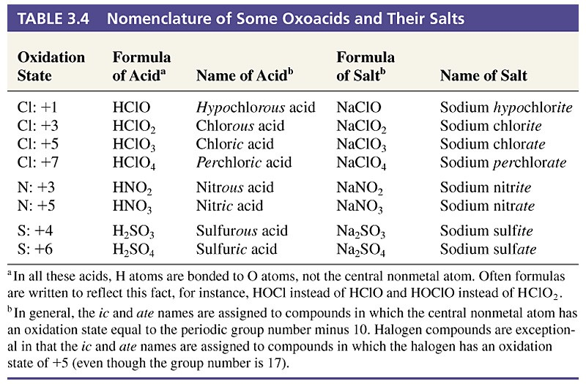
Slide <number> of 37
General Chemistry: Chapter 3
Prentice-Hall © 2002
Notes:
Chemistry 140 Fall 2002
Most oxoacids are ternary compounds composed of hydrogen, oxygen and one other nonmental.
Oxoacids are molecular compounds, salts are ionic compounds
Ic and ate names are assigned to compounds (rather than ite and ate as in the oxoanions) in which the central nonmetal atom has an oxidation state equal to the periodic group number – 10
For halogens ic and ate names are assigned to compounds in which the halogen has an oxidation state of +5.

Slide 35
Naming Organic Compounds
Organic compounds abound in nature
Fats, carbohydrates and proteins are foods.
Propane, gasoline, kerosene, oil.
Drugs and plastics
Carbon atoms form chains and rings and act as the framework of molecules.
Slide <number> of 37
General Chemistry: Chapter 3
Prentice-Hall © 2002

Slide 36
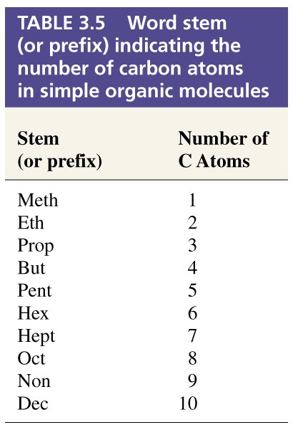
Slide <number> of 37
General Chemistry: Chapter 3
Prentice-Hall © 2002

Slide 37
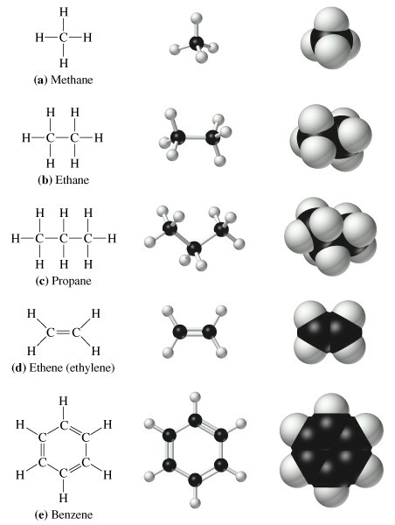
Visualizations of some hydrocarbons
Slide <number> of 37
General Chemistry: Chapter 3
Prentice-Hall © 2002

Slide 38
Visualizations of some hydrocarbons
Slide <number> of 37
General Chemistry: Chapter 3
Prentice-Hall © 2002

Slide 39
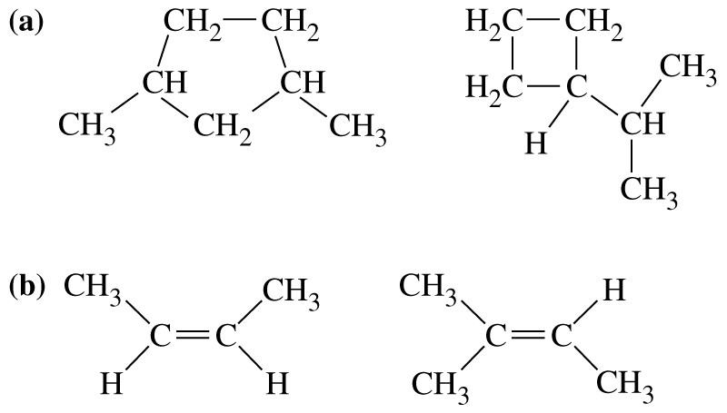
Isomers
Isomers have the same molecular formula but have different arrangements of atoms in space.
(c)
H
Slide <number> of 37
General Chemistry: Chapter 3
Prentice-Hall © 2002
Notes:
Chemistry 140 Fall 2002
These are structural isomers. The structures are different
these molecules do not have the same formula, they are different
c) Now these molecules have the same formula and ALSO the same connectivity. These are geometric isomers.

Slide 40
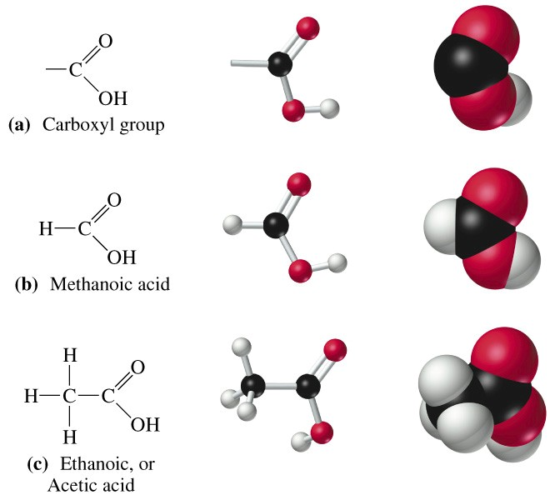
Functional Groups – carboxylic acid
Slide <number> of 37
General Chemistry: Chapter 3
Prentice-Hall © 2002

Slide 41
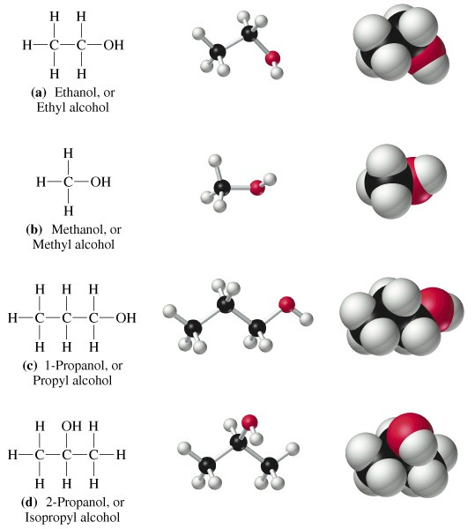
Functional Groups - alcohol
Slide <number> of 37
General Chemistry: Chapter 3
Prentice-Hall © 2002

Slide 42
Chapter 3 Questions
3, 5, 12, 24, 35, 46, 53, 61, 57, 73, 95, 97
Slide <number> of 37
General Chemistry: Chapter 3
Prentice-Hall © 2002

